Slide 1
Classification of News Articles B-Tech Project
-Bhawna Rawat (Y13uc068)
-Pushpendra Khandelwal(Y13uc212)

Slide 2
Introduction
What
Classification of News Articles into various categories.
Why
Current Situation
Future Prospective.
How

Slide 3
Basic Design
Requirements :
1. Survey
2. Transforming Raw Data to Structured Data .
Language Used- Python(WebScraping) and R(for Pre-processing).
Library Used – Beautiful Soup(Python).

Slide 4
Web Scraping
The art of data scraping used for extracting data from websites. Web scraping software may access the World Wide Web directly using the HTTP, or through a web browser.
From where
Financial Express
Hindustan time
Economic time
Indian Express
The Hindu

Slide 5
Classification Hierarchy Structure
Education/ News
Academic
Research
In-Trends
Higher Studies/Future Careers
Jobs And Internship
GRE, Tofel, Gate
General

Slide 6
Examples
For the first time in almost a decade, Google to give placements a miss at most IITs.
Indian scientists show new way to transform CO2 into methanol.
Self-driving scooter that works indoors as well as out.
Commercial apps will soon be able to strike open data gold.

Slide 7
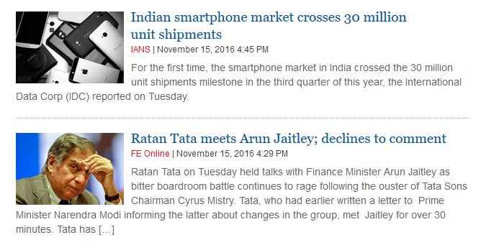
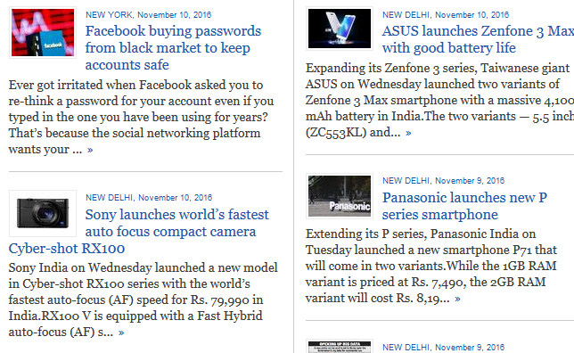
Web Sites clips

Slide 8
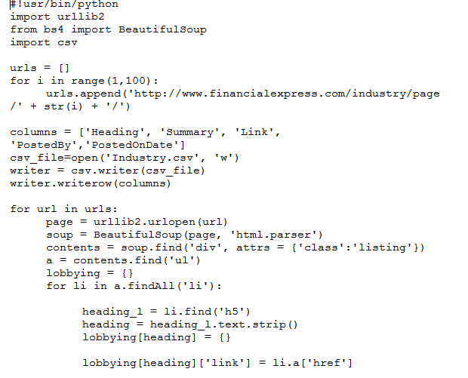
Code

Slide 9
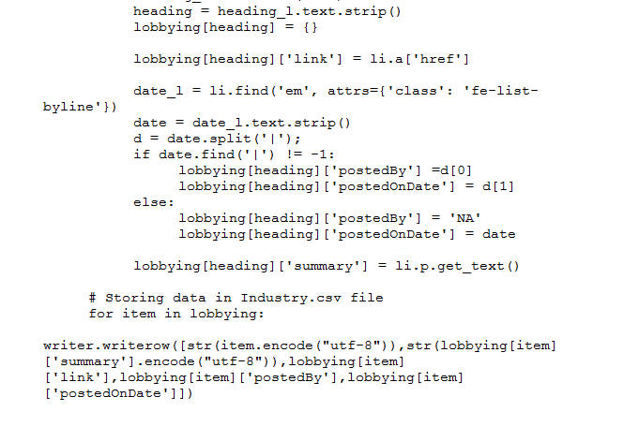

Slide 10
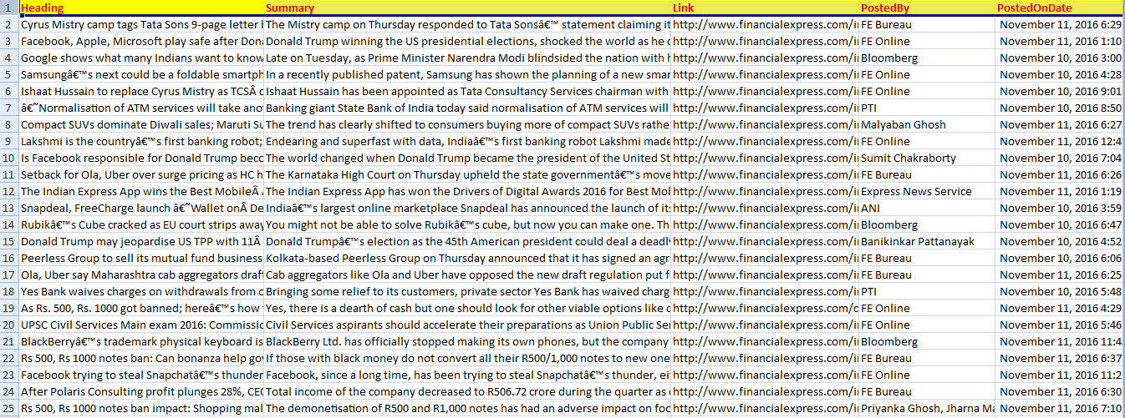
News Records

Slide 11
Data Set
Training Set – uniformly distributed 20,000+ news records of various categories.
Cross Validation Set –around 1,000 news records.
Test Set-more than 100 news records.

Slide 12
Future Plans
Pre-processing
Removing redundant News records.
Cleaning
Removing Stopwords, Punctuation, Numbers.
Converting all Uppercase to LowerCase.
Stemming

Slide 13
Future Plans cont.
Creating a Suitable Model using Machine Learning Algorithm
Namely Support Vector Machine(SVM), Bayesian Classifier
Validating the model based on accuracy, precison and recall.

Slide 14
What more can be implemented?
More generalised Structure for classification.
A User Interface could be generated.
A Plugin.

